Slide 1



A Risk Methodology and Tool for Managing Risks incurred in Large Scale Construction Projects
Nam LE, M.eng, PhD
1. Chair of Urban Risk and Resilience, UEH University | www.iscm.ueh.edu.vn
2. Director, Arcadis (Philippines and Indian offices) | www.arcadis.com
3. Founder, ASQ Vietnam Co. Ltd 4. Business Advisor, ICEB Solutions (BIM) | www.asq.vn www.icebsolutions.com
5. Business Advisor, EMAPTA | www.emapta.com

Slide 2
Content
Introduction
Risk Estimation Methodologies
Qualitative Method
Quantitative Method
An Enhanced Approach for Risk Estimation
Intensity vs Likelihood
Risk as a Combination and Not Multiplication
Risk Register
Discussions
02
Work packages
Asset Management, Data Analytics and Offshore Staffing from Vietnam https://www.asq.vn
Institute of Smart City and Management https://www.iscm.ueh.edu.vn
Notes:
Định nghĩa trong luật Kiến trúc của Việt Nam

Slide 3






Bio of the Speaker
Prof. Kiyoshi Kobayashi
Kyoto University
Prof. Kiyoyuki Kaito
Osaka University
Prof. Bryan Adey
ETH Zurich
02
Work packages
2006-2009
2010
2010-2017
Asset Management, Data Analytics and Offshore Staffing from Vietnam https://www.asq.vn
Institute of Smart City and Management https://www.iscm.ueh.edu.vn
Notes:
Định nghĩa trong luật Kiến trúc của Việt Nam

Slide 4
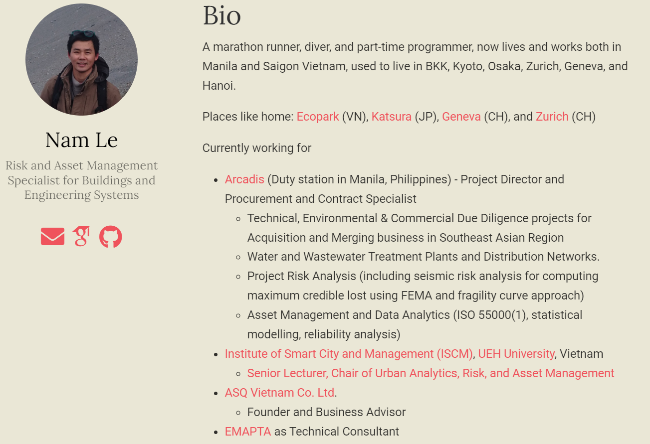
Bio of the Speaker
I am interested in applied mathematics, statistics, and operations research for optimal management and development of intervention strategies for buildings, infrastructure, and engineering systems.
Urban risk and resilience
Asset management for Buildings and Engineering Systems
Project & Procurement Management
Data Analytics and Solutions
Website: https://namkyodai.github.io
Email: namlt@protonmail.com
Mobile: VN: +84-983780100 (Lines, Whatsapp, Viber, Zalo)
IN: +91-9810444576
02
Work packages
Asset Management, Data Analytics and Offshore Staffing from Vietnam https://www.asq.vn
Institute of Smart City and Management https://www.iscm.ueh.edu.vn
Notes:
Định nghĩa trong luật Kiến trúc của Việt Nam

Slide 5
Risk Methods
Qualitative Method
Selection of Which Risk Method depends on
Perception & understanding of stakeholders
Level of management
Operational objectives
Availability of data
Measurement methodologies
Expert’s opinions
Risk | Color Code
Low | Green
Medium | Amber
High | Red
Quantitative Method
Risk = Probability x Consequence
Risk = Hazard x Vulnerability x Consequence
Asset Management, Data Analytics and Offshore Staffing from Vietnam https://www.asq.vn
Institute of Smart City and Management https://www.iscm.ueh.edu.vn
Notes:
Định nghĩa trong luật Kiến trúc của Việt Nam

Slide 6
An Enhanced Method
Likelihood | Consequence
 | j = 1 | j = 2 | j = 3 | j = 4 | j = 5
i = 1 | 1 | 2 | 3 | 4 | 5
i = 2 | 2 | 4 | 6 | 8 | 10
i = 3 | 3 | 6 | 9 | 12 | 15
i = 4 | 4 | 8 | 12 | 16 | 20
i = 5 | 5 | 10 | 15 | 20 | 25
Likelihood |  | Consequence
Scale | Definition | Scale | Definition
i = 1 | Very unlikely | j = 1 | Minor
i = 2 | Unlikely | j = 2 | Major
i = 3 | Possible | j = 3 | Severe
i = 4 | Likely | j = 4 | Critical
i = 5 | Almost certain | j = 5 | Catastrophic
Intensity | Consequence
 | j = 1 | j = 2 | j = 3 | j = 4 | j = 5
i = 1 | 1 | 3 | 10 | 13 | 14
i = 2 | 2 | 5 | 11 | 15 | 19
i = 3 | 4 | 6 | 12 | 17 | 23
i = 4 | 7 | 9 | 18 | 21 | 24
i = 5 | 8 | 16 | 20 | 22 | 25
Asset Management, Data Analytics and Offshore Staffing from Vietnam https://www.asq.vn
Institute of Smart City and Management https://www.iscm.ueh.edu.vn
Notes:
Định nghĩa trong luật Kiến trúc của Việt Nam

Slide 7
Discussion, Q&A
Asset Management, Data Analytics and Offshore Staffing from Vietnam https://www.asq.vn
Institute of Smart City and Management https://www.iscm.ueh.edu.vn
Notes:
Định nghĩa trong luật Kiến trúc của Việt Nam

